Slide 1

Computer Animation
Lab 1 - Lab Intro + A3 Mass Spring Assignment
COMP 477

Slide 2
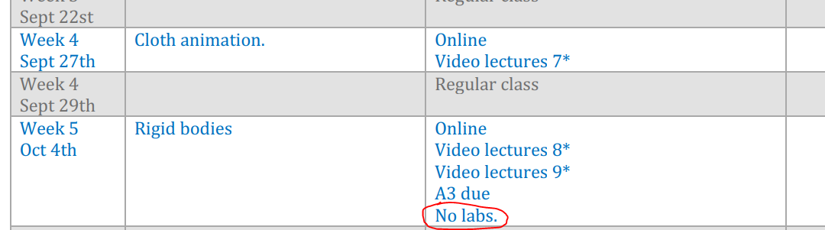
Intro
Schedule:
Mon, Wed: 2:45 - 3:30 PM in H827
Check Lab Schedule on Moodle:

Slide 3
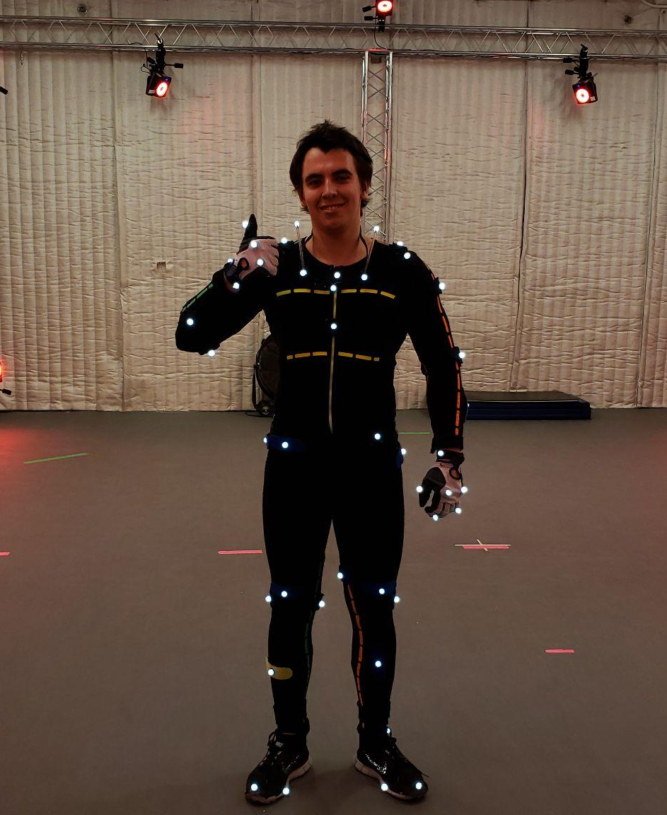



TA
Maksym Perepichka
maksym@perepichka.com
DM: Maksym Perepichka
#assignments channel

Slide 4
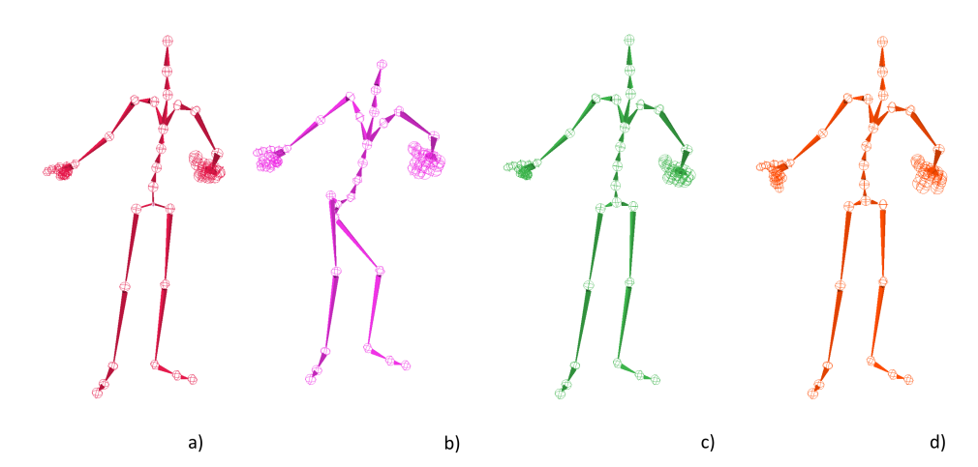
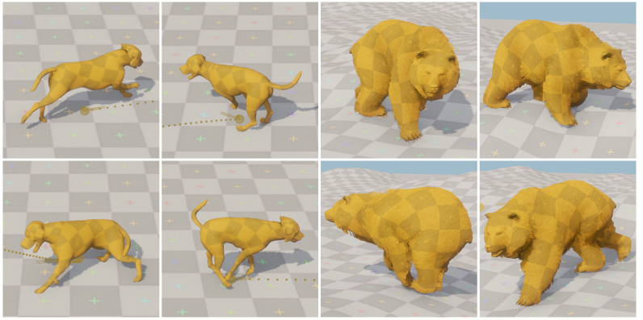
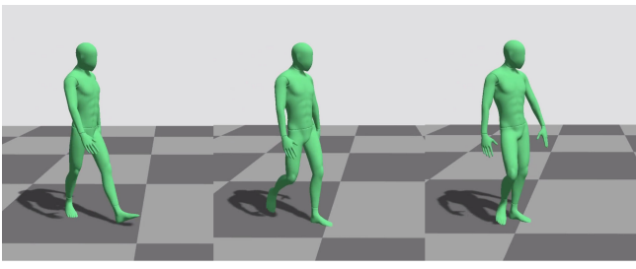
About
About: PhD Student @ Concordia
Also Masters + Undergrad…
Researcher Trainee @ Ubisoft LaForge
Research:
Animation, MOCAP, Motion Controllers, 3D/4D Reconstruction, Deep Learning

Slide 5
Course Tracks
Assignment Track
A3
Mass Spring
A3 Demo
A1 FK
A1
Demo
A2
IK
A2
Demo
Project Track
Project Proposal
Project Demo

Slide 6
A3 - Mass Spring
Goal:
Implement mass spring simulation, using explicit euler (implicit is bonus)
Instructions:
https://moodle.concordia.ca/moodle/pluginfile.php/5069801/mod_resource/content/0/A3.pdf
Github:
https://github.com/tiperiu/COMP477_A3

Slide 7
Assignment - Using Lab Machines
For access to Qt Creator, either:
Boot into linux, open terminal, run the following command:
“module load qt”
“qtcreator”
Use Windows computers in H813 → QtCreator is installed

Slide 8
Assignment - Setup
Setup:
Clone or download git repo
Install Qt 5 + QT Creator (takes a while)
Implement assignment in a1solution.cpp
You don’t need to install all 50+GB of QT. Simply installing the Developer Tools (Qt Creator) along with a compatible compiler (usually MinGW or MSVC) will suffice. If you’re not sure on the compiler, install both and test them when compiling.

Slide 9
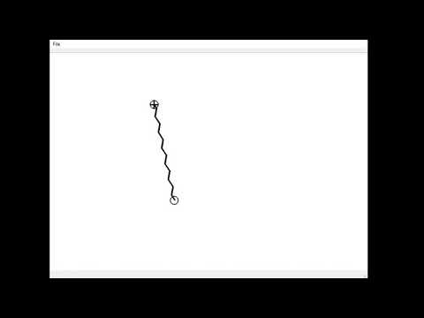
Assignment - Solution Preview
More info on expected behavior + implementation details will come in future labs, for now, here is a preview:

